Slide 1
EagleSat-II
On Board Computer (OBC) Subsystem
David Stockhouse – OBC Subsystem Lead

Slide 2
OBC Overview
Architecture Description
Payload Computer
Bus Computer

Slide 3
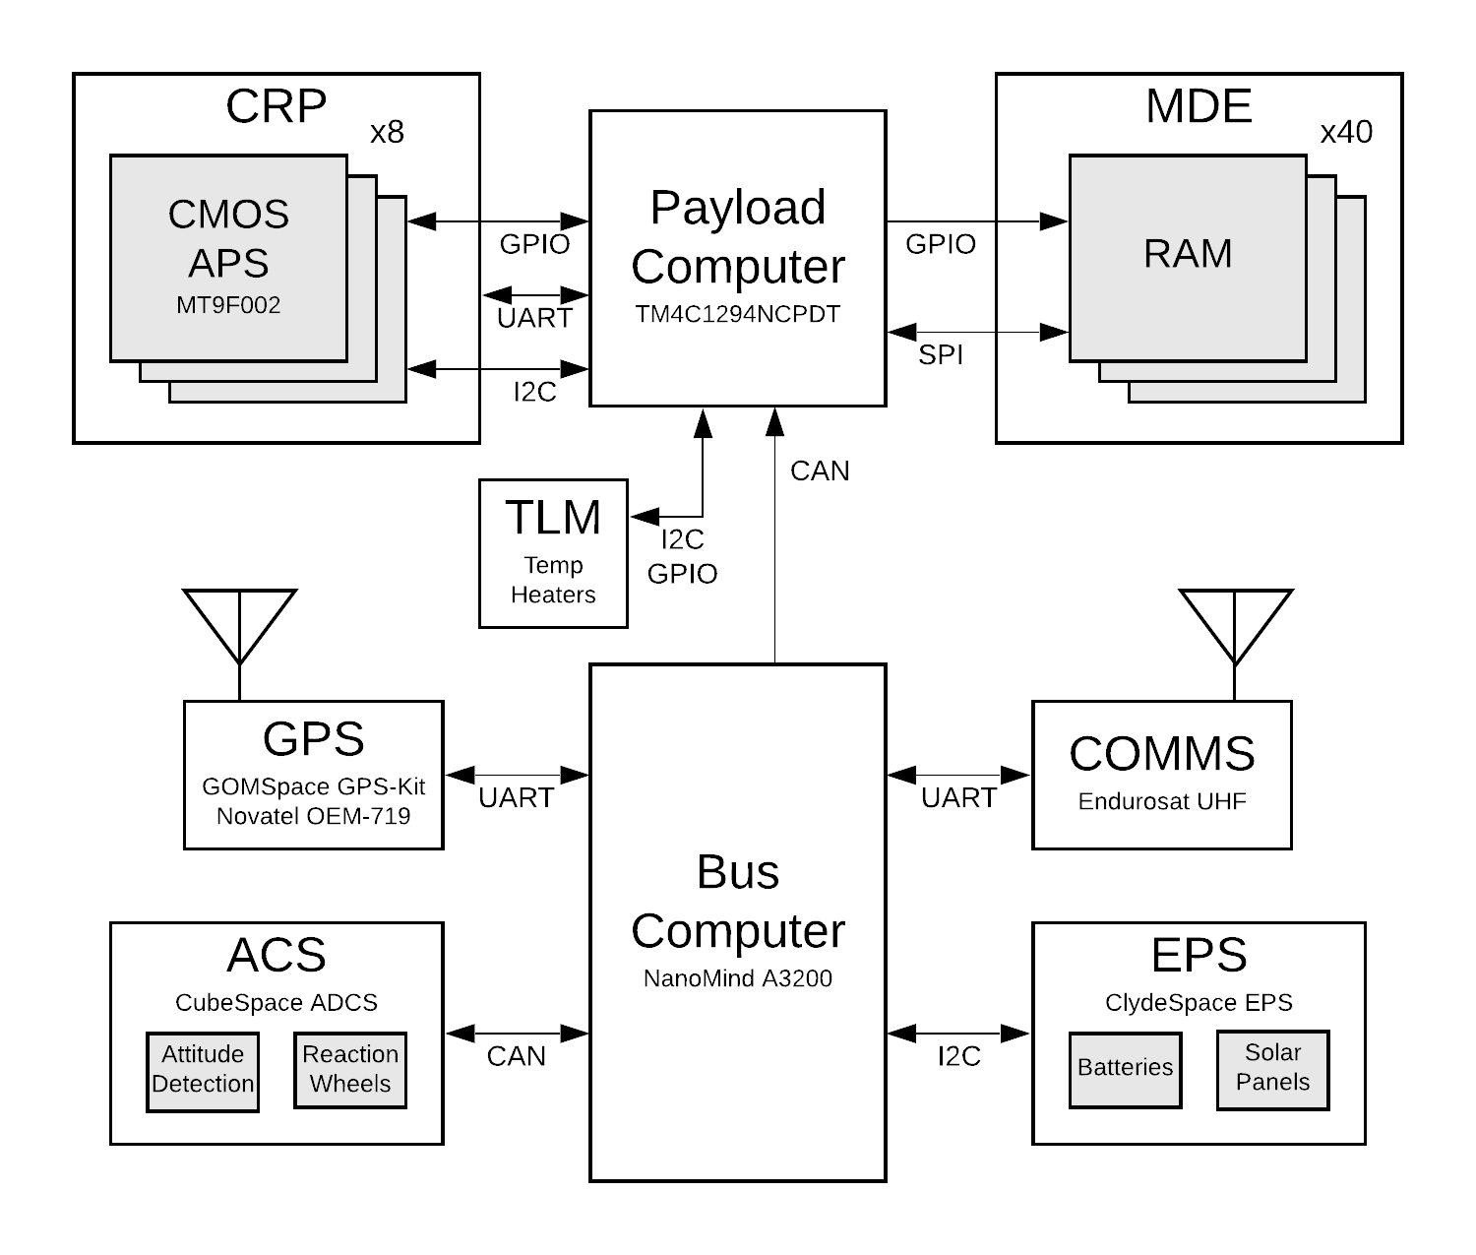
Architecture Description
Figure 1: System-Level Block Diagram

Slide 4
Architecture Description
Two independent computer systems
Payload computer (TI TM4C (MCU) + Xilinx Artix-7 (FPGA))
Controls all payload instruments (cameras and RAM) and some telemetry instruments
Processes all payload data and reports to bus computer
Developed in-house
Bus computer (GOMSpace Nanomind A3200)
Connects to all other subsystems, including payload computer
Processes all bus system data and telemetry
Communicates with the ground through COMMS subsystem
Commercial off-the-shelf component

Slide 5
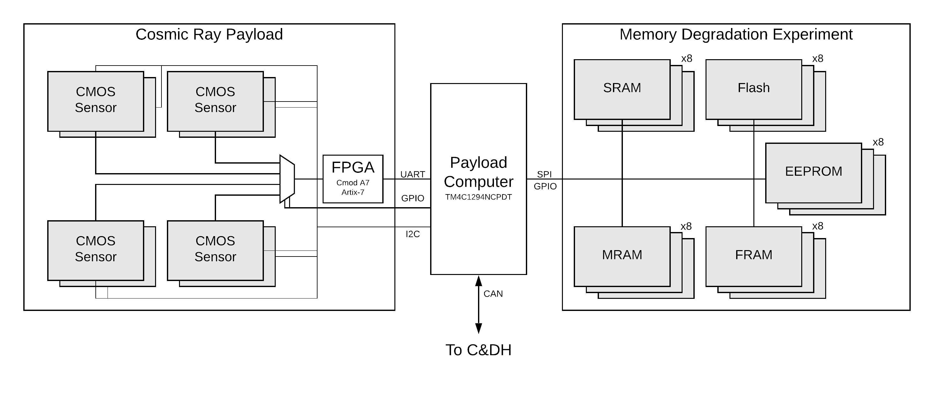
Payload Stack
Figure 2: Payload Subsystem Block Diagram

Slide 6
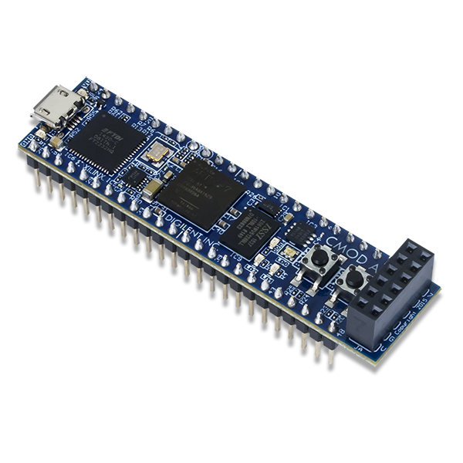
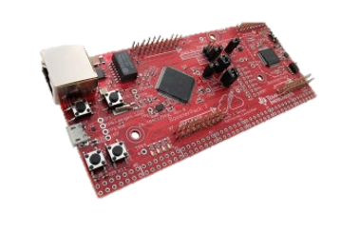
Payload Computer – Overview
Ease of development for the team critically important
Microcontroller + FPGA to meet instrument timing requirements
TM4C processor to leverage team experience from coursework
Artix-7 breakout to leverage team experience from coursework and ease PCB design
Simple software loop with timer interrupt for instrument control
Figure 3: EK-TM4C1294XL development kit​
http://www.ti.com/tool/EK-TM4C1294XL​
Figure 4: Cmod A7 development kit​
https://www.xilinx.com/products/boards-and-kits/1-f3zdsm.html​

Slide 7
Payload Computer – Software
Ease of development a priority
Payload software being developed by each payload subteam independently
No need for high-overhead complex solution like RTOS
Simple cyclic executive with interrupts

Slide 8
Payload Computer – Board Design
Prototype PCB early in design/build process
Parts and interfaces selected, early schematic designs
Pin and peripheral assignments planned, subject to change
MDE prototype already running on less powerful TM4C
Black box test of descaled system during high-altitude balloon flight
In processing of migration to flight hardware equivalent
CRP prototype in development
MCU + FPGA development difficult – difficult to test either until both complete

Slide 9
Payload Computer – Additional Telemetry
Bus computer doesn’t have any available PC/104 GPIO pins
COTS parts limited to what already exists on hardware
Payload computer designed in house – as many extra interfaces as we want
Temperature sensors
In-house PCBs can include as many sensors as desired routed to unused PC/104 pins
Cubesat I2C bus free for use with mission-critical systems
Some unoccupied PC/104 pins can be used for thermal measurements throughout cubesat structure, outside of payload stack
ACS patch heater
Small PCB close to ACS with power control circuitry
Activated by payload computer based on temperature measurements

Slide 10
Bus Computer – Overview
Interfaces with all other bus systems and payload stack
Receives and interprets commands from the ground
Packetizes data and telemetry for downlink
Composed of commercial off-the-shelf (COTS) components
Minimize risk from in-house development for mission-critical system
Time can be spent testing and validating requirements

Slide 11
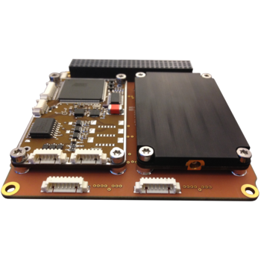
Bus Computer – Hardware
GOMSpace NanoMind A3200 + NanoDock DMC-3
NanoDock routes UART between NanoMind and GPS kit
CAN and I2C routed to cubesat bus headers
Additional debugging and general purpose UARTs available through JST sockets
Figure 4: NanoDock with two daughterboards
https://gomspace.com/shop/subsystems/docks/nanodock-dmc-3.aspx

Slide 12
Bus Computer – Flight Software (FSW)
GOMSpace software includes integration with FreeRTOS
GOMSpace shell (GOSH) for UART debugging during development
F Prime – Open-source NASA JPL FSW architecture and framework
Object-oriented model of the FSW as components linked by ports
Provides framework for ease of software development
Comes with debugging and testing environments and tools
Support porting to FreeRTOS offered from creators at JPL

Slide 13
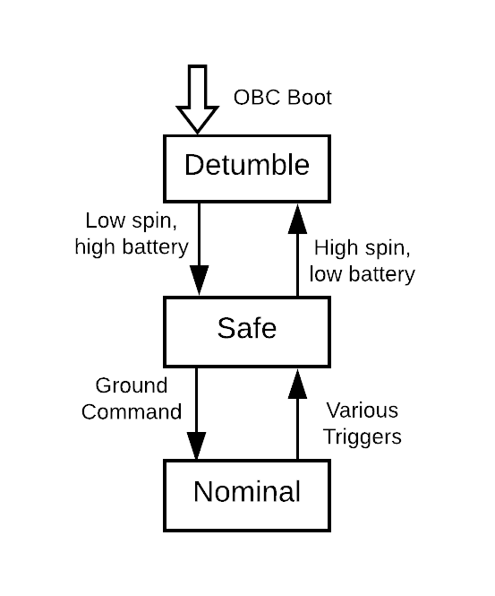
Bus Computer – Operating Modes
Detumble
Entered at every boot, all subsystems off except OBC and ACS
ACS detumbling the spacecraft until low rotation rate
Safe mode
Spacecraft reduced to barebones operation
Payloads off, COMMS attempts to establish communication with ground station
Normal operating mode
Main science mission underway
Payloads fully operating, ACS stationkeeping
Figure 7: EagleSat-II Operating Modes

Slide 14
Questions?

